Slide 1
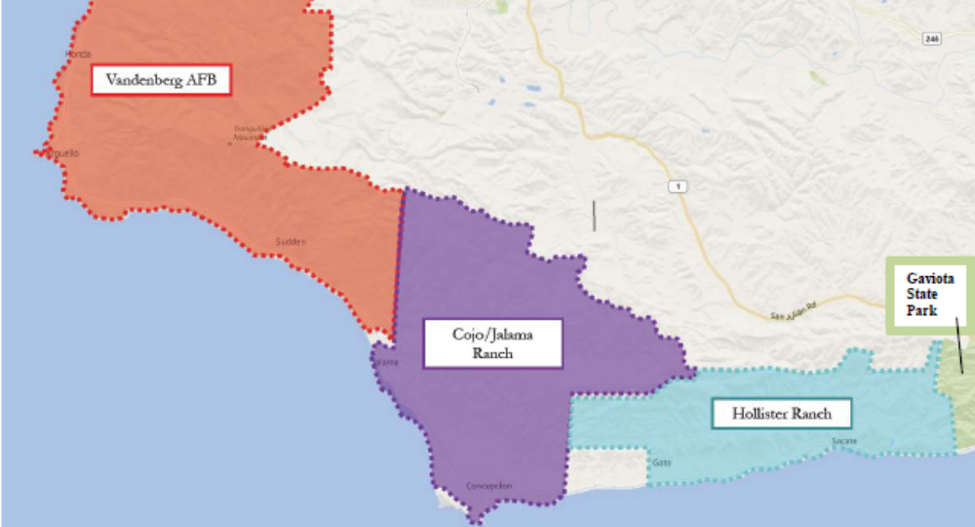
Hollister Ranch Public Access History & Settlement Agreement
Hollister Ranch
Hollister Ranch

Slide 2
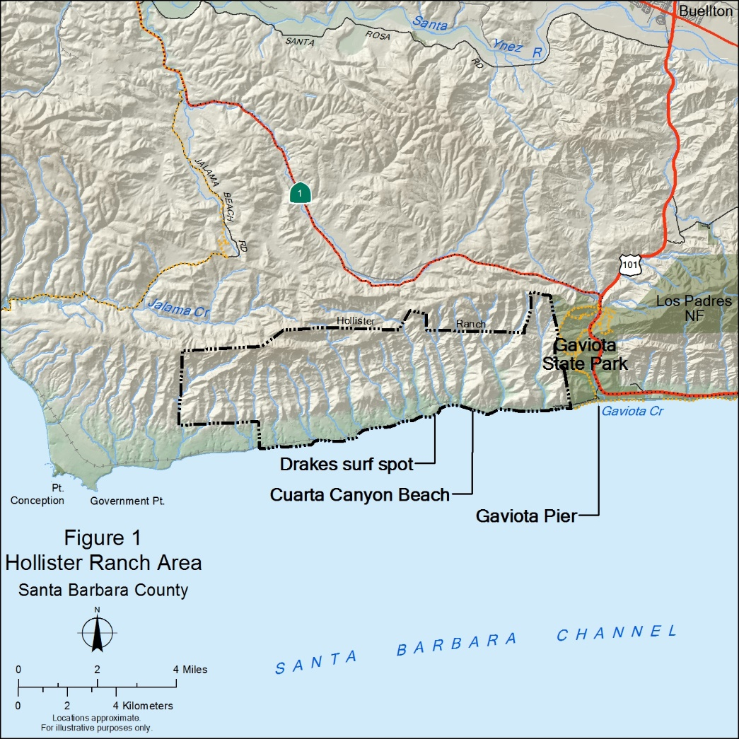
Hollister Ranch History
Hollister Ranch has been operating as a cattle ranch for over 100 years.
14,500 acres in size; subdivided into 135 parcels of about 100 acres each prior to the Coastal Act.
8.5 miles of shoreline.
Private entrance gate/Private Ranch Road prevents public from entering into the Ranch property.

Slide 3
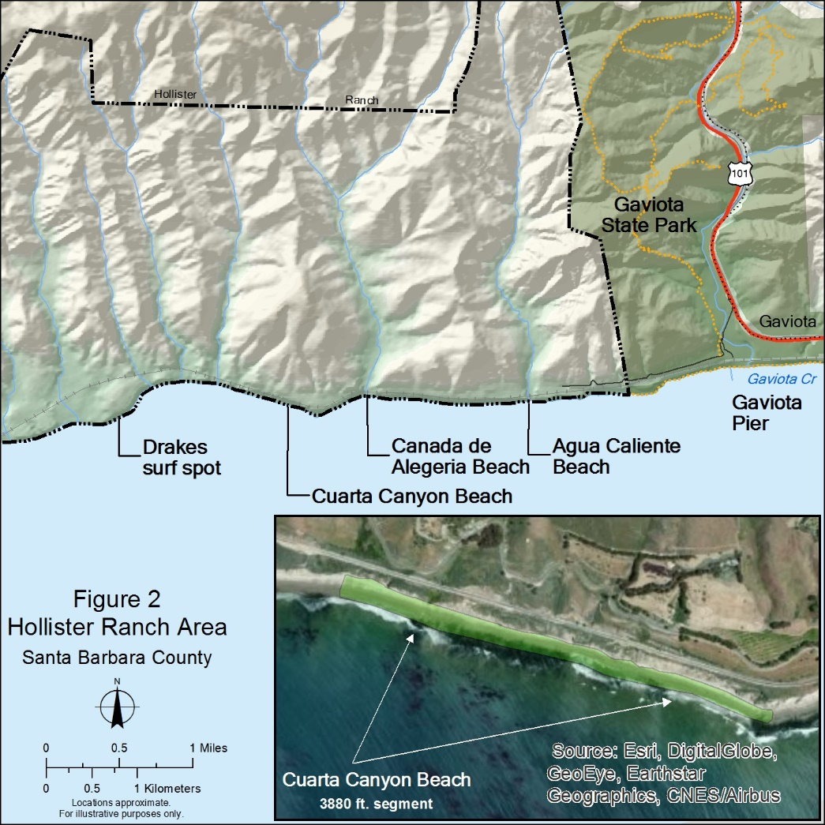
CDP History
1980 CCC approved a CDP for a YMCA Ocean Camp, on parcel located about 2 miles west of Gaviota State Park.
Inland parcel was for overnight camper use & a beach parcel for day use.
CDP required that the beach parcel be opened to 50 members of the public per day.
Transit to the beach would be via a shuttle system (no private vehicles or pedestrian past the HR gate).

Slide 4
CDP History – Continued
In 1982 the YMCA satisfied the condition to record both Lateral and Vertical OTDs & the Permit was issued.
1982+ the YMCA constructed some development on the inland parcel and exercised the CDP.
1984 HROA buys the YMCA parcel & sells the property in 1986.
2103 Coastal Conservancy accepts the OTDs & a lawsuit is immediately filed by the HROA.

Slide 5
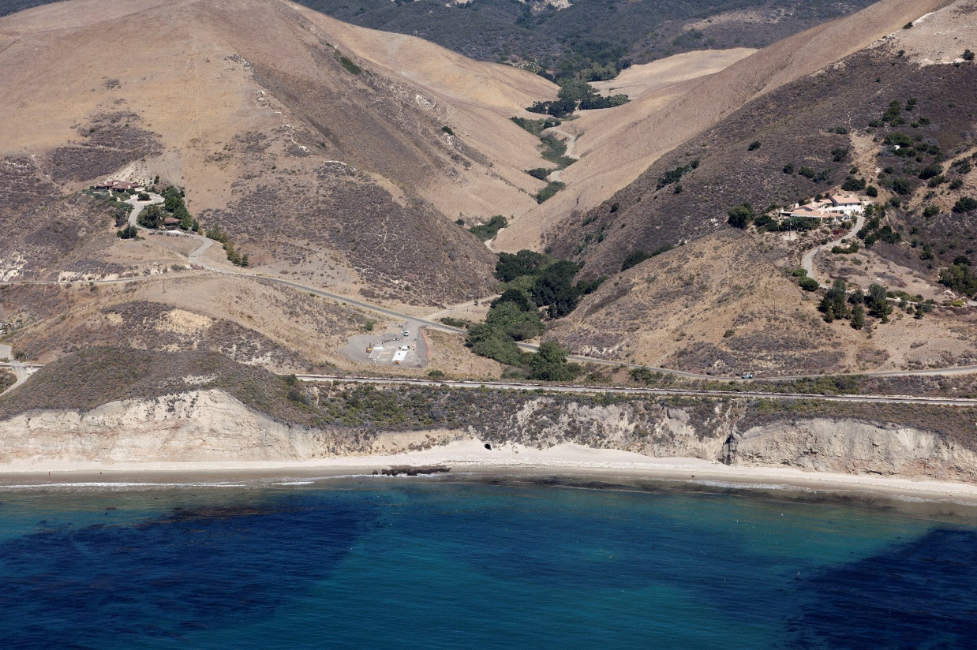
OTD Easement
Vertical OTD Easement follows the Cuarta Canyon Creek, through a drainage tunnel to Cuarta Canyon Beach.
Cuarta Canyon Creek
Tunnel

Slide 6
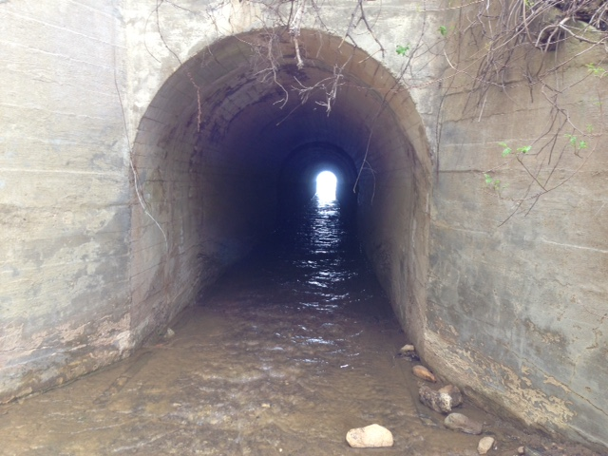
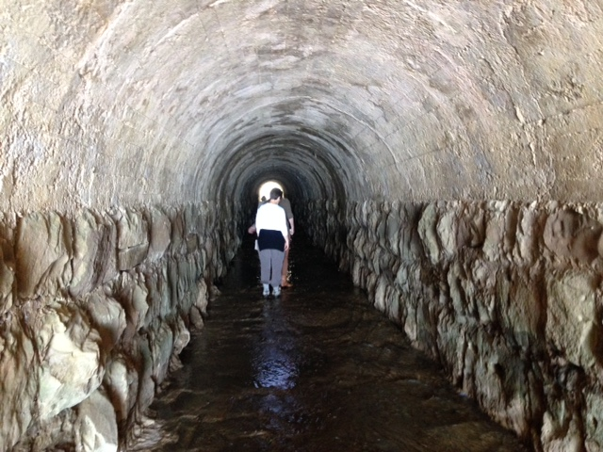
Drainage Tunnel
Tunnel Entrance
Inside Tunnel

Slide 7
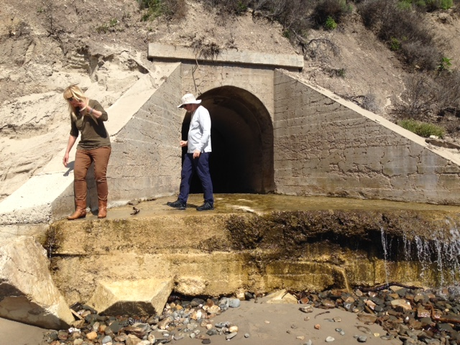
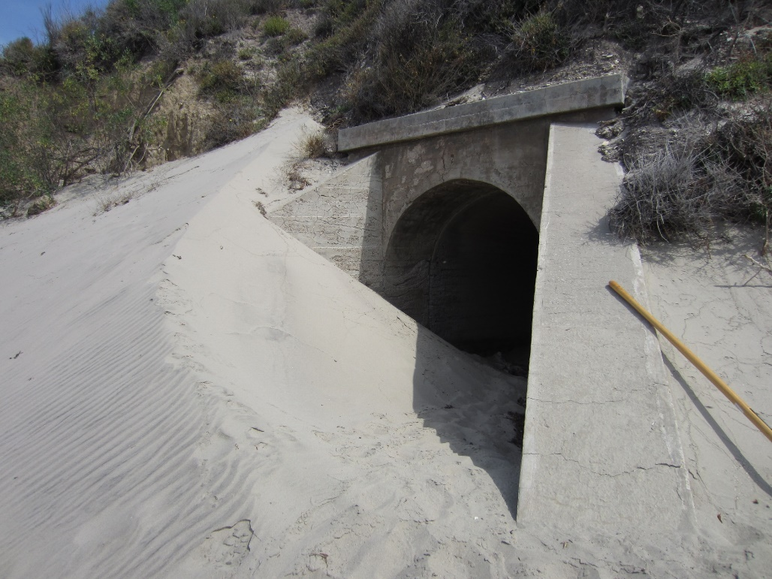
Tunnel Exit onto Beach Showing Seasonal Beach Elevations. di

Slide 8
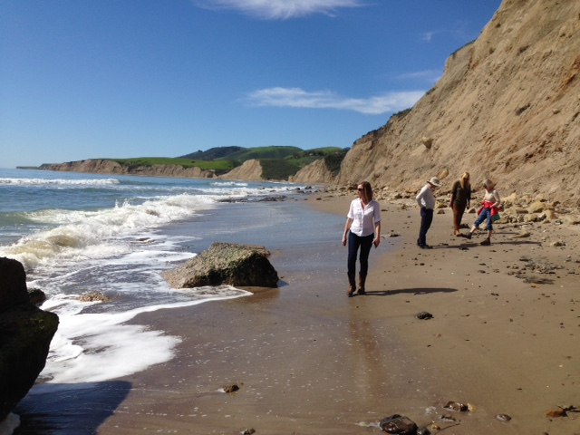
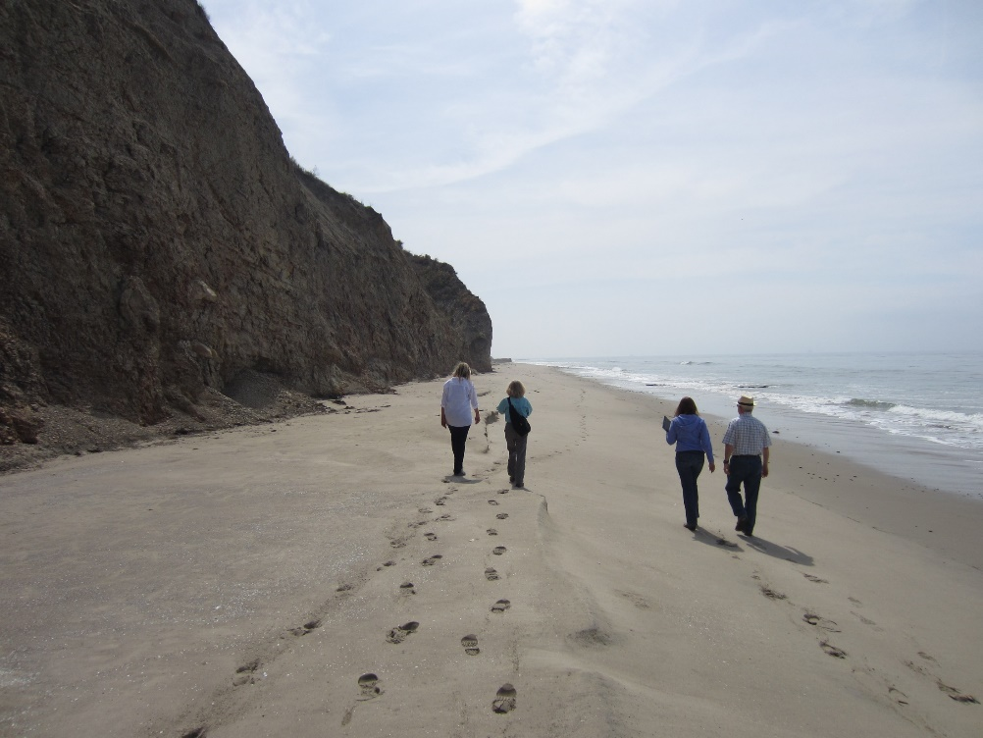
Beach down coast of the tunnel showing seasonal beach width and profile differences.
101 Total Planning Items
Cuarta Canyon Beach lateral OTD Easement is 3,880 ft. long.
Bluff Top trail was also contemplated when beach was impassible.

Slide 9
Settlement Agreement – Programs
Substitutes the YMCA Managed Access Program with an alternative managed access program operated jointly by the SCC and the HROA & a license for public beach access at Curata Canyon Beach.
Managed Access Program – HROA will commit in perpetuity to a managed access program involving two programs for 44 public access opportunities annually (844 people). Programs would target disabled/special needs children and underserved youths.
SCC administered nonprofit educational and recreational beach programs for groups of 20 people; 20 times per year. Total new users = 400 people per year.
HROA guarantees that their pre-existing voluntary K-12 Tide Pool Program become permanent and would include 24 events per year up to 20 people. Total users = 444
The programs can utilize other Hollister Ranch beaches that have facilities such as restrooms and showers.
Tidepool School Program
ss program involving 44 public access opportunities annually

Slide 10
Settlement Agreement - License
License – HROA will grant license for public access over the same 3,880 feet of beach that was subject to the YMCA OTD.
Passive recreational use including beaching of small watercraft (oceangoing kayaks, surfboards, paddleboards, soft-bottomed boats such as zodiacs).
Primarily accessible from ocean.
Irrevocable unless a public entity files a condemnation action for public access or recreational use. S

Slide 11
Potential Funding sources for Managed Access program
In 1982, Legislature added Section 30610.8 to the Coastal Act, establishing an in lieu fee program for HR with the intent to resolve disputes between State and HR regarding public access requirements for new development.
Owners pay $5,000 for each CDP in lieu of providing Public Access. No inflationary escalator was included.
In lieu fee account is currently contains $290,000, held and administered by the SCC.
Pursuant to a 1984 CDP issued to Chevron for the Point Arguello project, a $1,000,000 in lieu fee was paid to the Santa Barbara County, to be used for future public access improvements at HR.

Slide 12
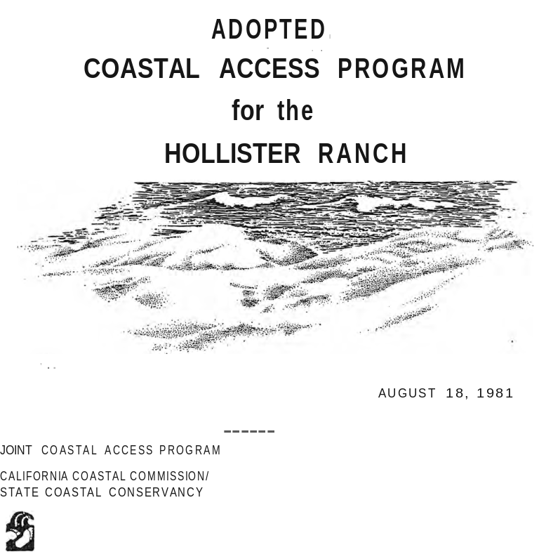
Hollister Ranch Beach Access Program
In response to Section 30610.8 of the Coastal Act, the CCC and SCC jointly prepared and adopted the Hollister Beach Access Program in 1981.
The Plan calls for a phased and monitored approach to opening access to the Ranch.
Proposed pedestrian, bicycle, and shuttle van access into various beach sites.
Phased implementation, with 100-500 users per day; implementation led by the SCC.
Beach facilities proposed.
Protection of sensitive habitat areas as well as addressing Ranch owner’s privacy.

Slide 13
Potential Future Access Opportunities to Hollister Ranch
Repairs to boat launch hoist from Gavoita Pier are planned by State Parks which would help to facilitate boat access to Curata Beach.
A future concessionaire could provide the public boat trips to Curata Canyon Beach.
Partner with State Parks, SCC and a non-profit to develop a low cost overnight accommodations & underserved youth access programs at Gaviota State Park which could participate in the Managed Beach Access Program to the Hollister Ranch beaches.

